Slide 1
Secure Document Management Framework using Blockchain
Group ID : 24
Iruthayaraja A.M. EG/2018/3344
Poovallal J. EG/2018/3421
Sajipranath Y. EG/2018/3445
Supervised by – Dr. Rajitha Udawalpola

Slide 2
Literature Review samples
DOC-BLOCK: A Blockchain-Based Authentication System for Digital Documents.
Online Document Management System for Academic Institutes.
Secure Document Management and Distribution in an Open Network Environment.
XDoC-WFMS: A Framework for Document Centric Workflow Management System.

Slide 3
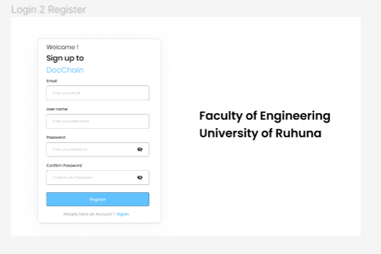
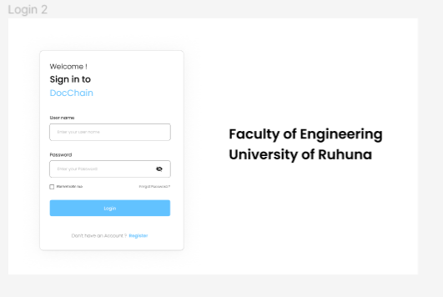
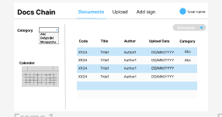
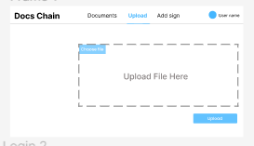
Figma UI

Slide 4
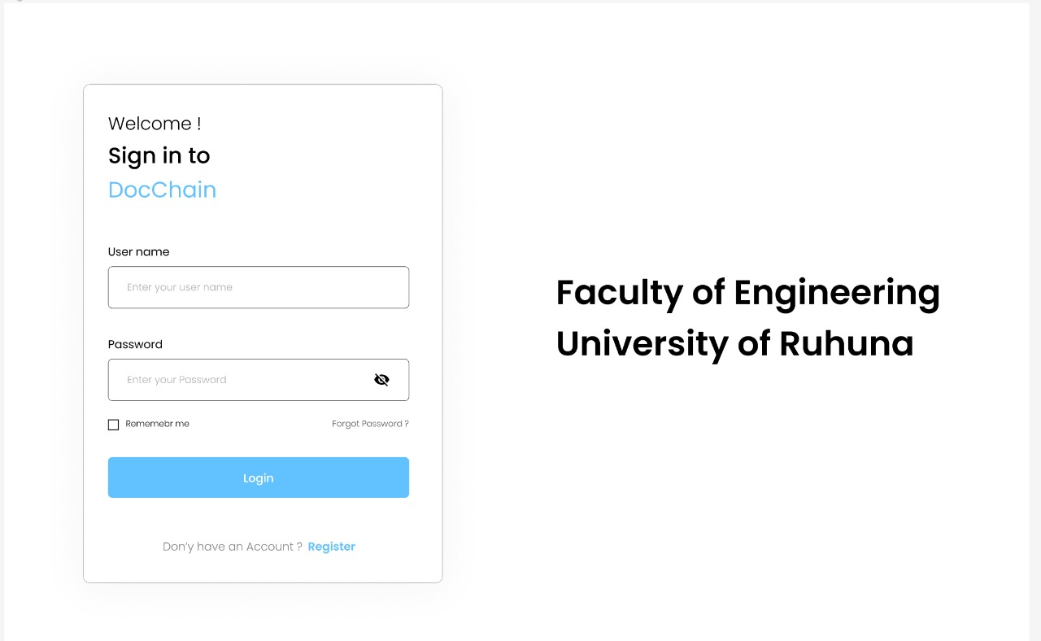
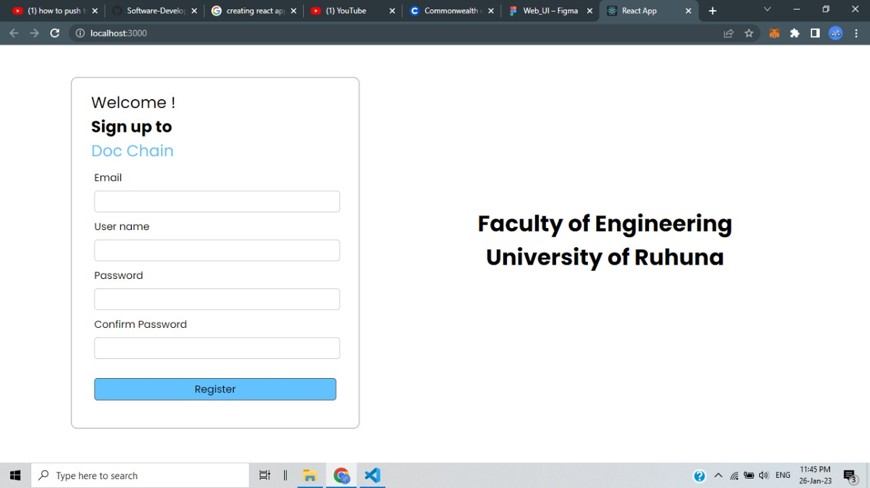
Log-In/Sign-Up pages

Slide 5
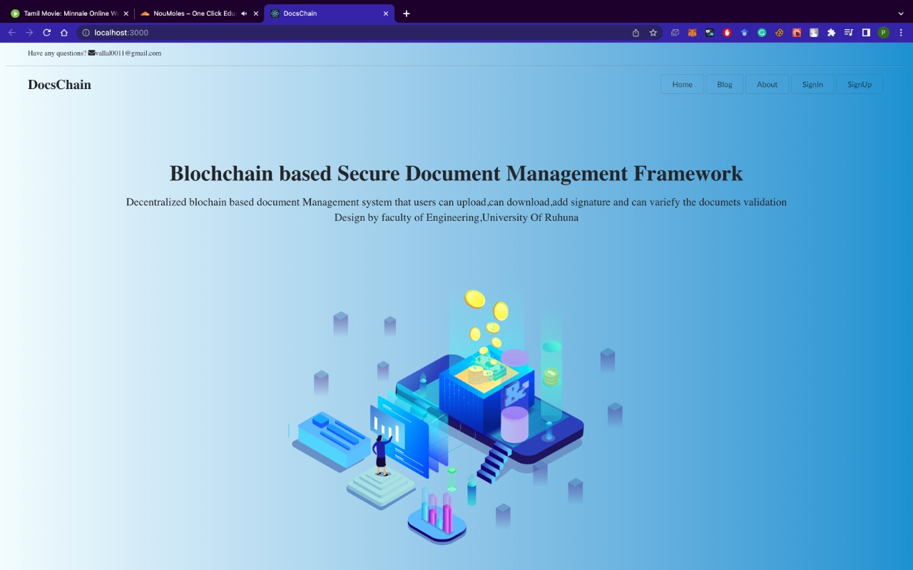
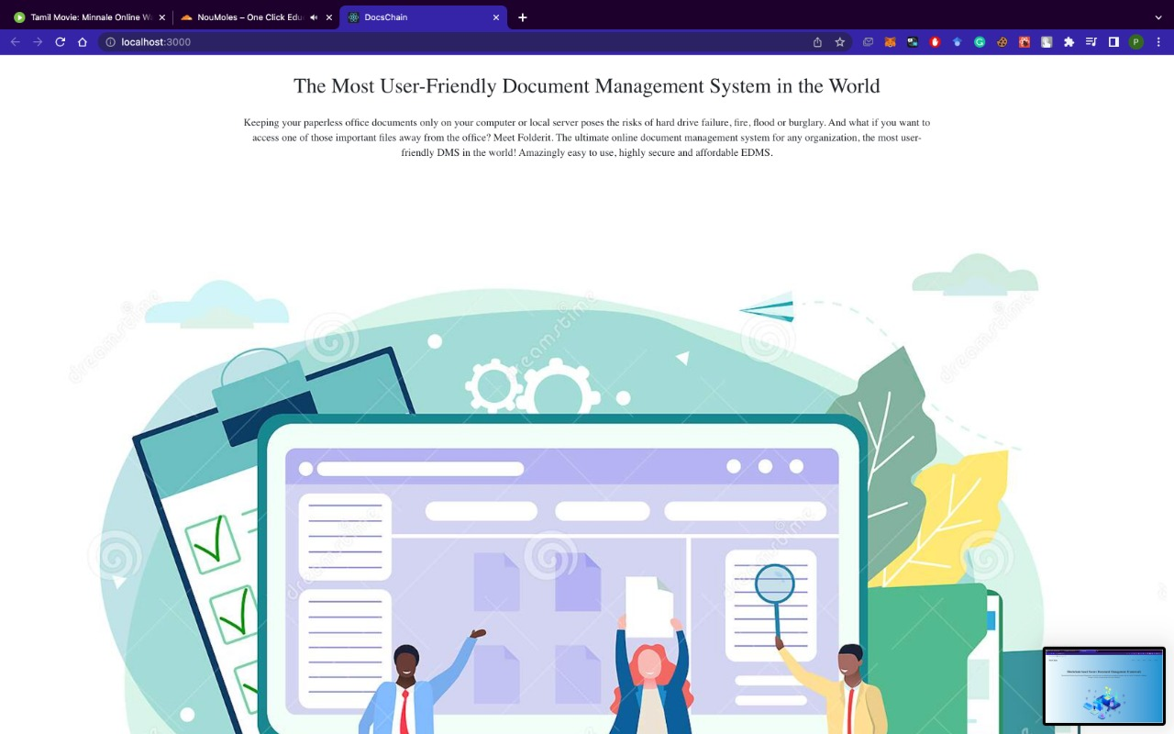
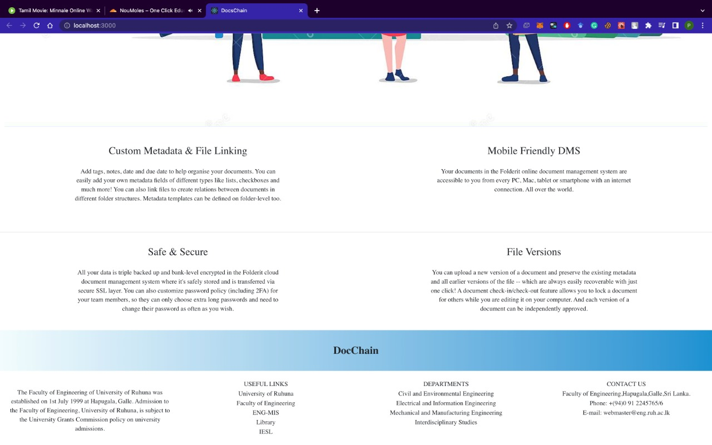
Landing page

Slide 6
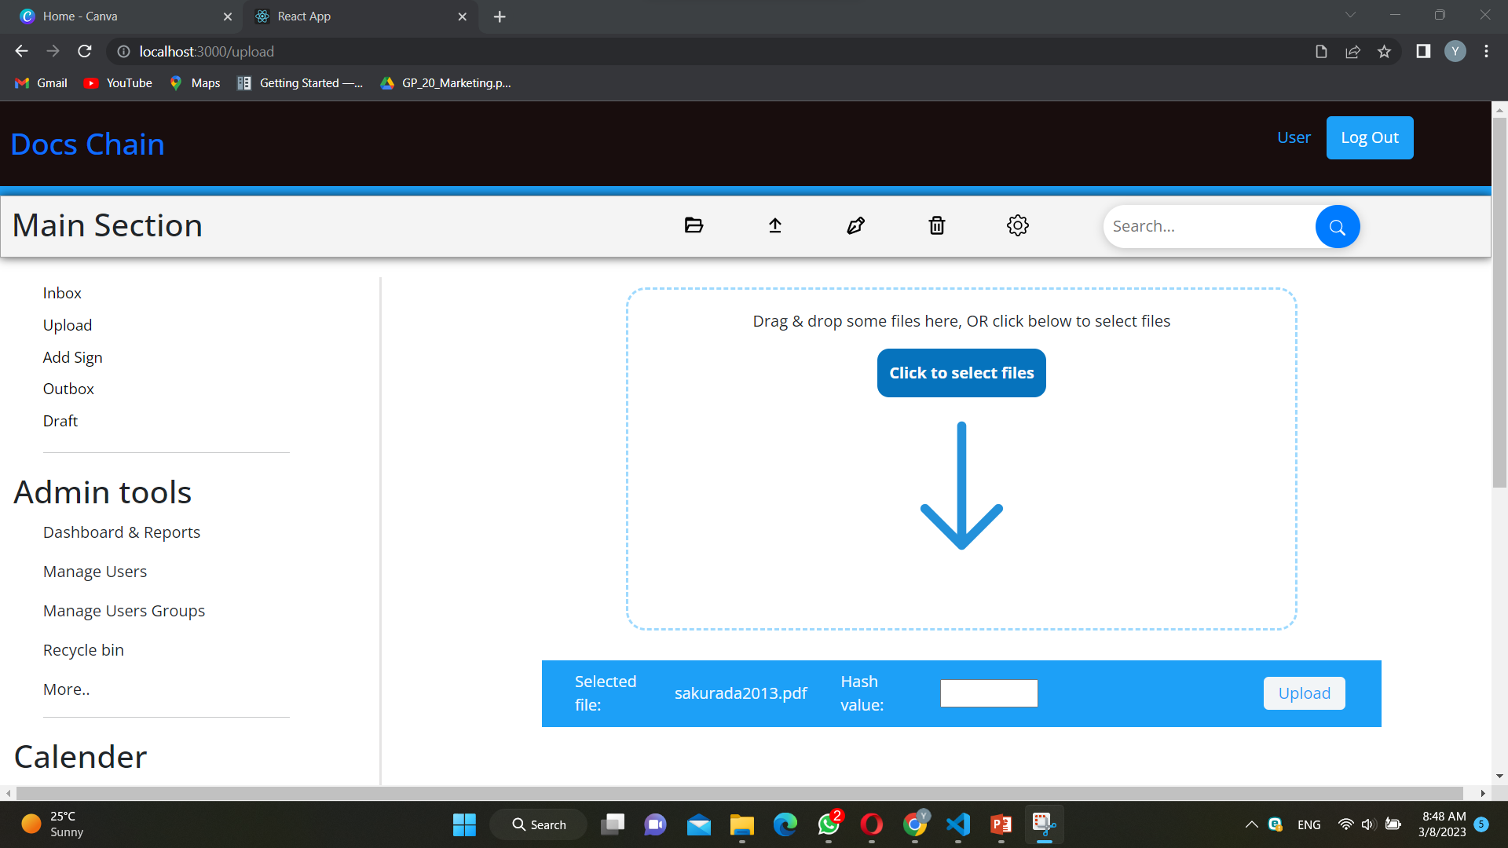
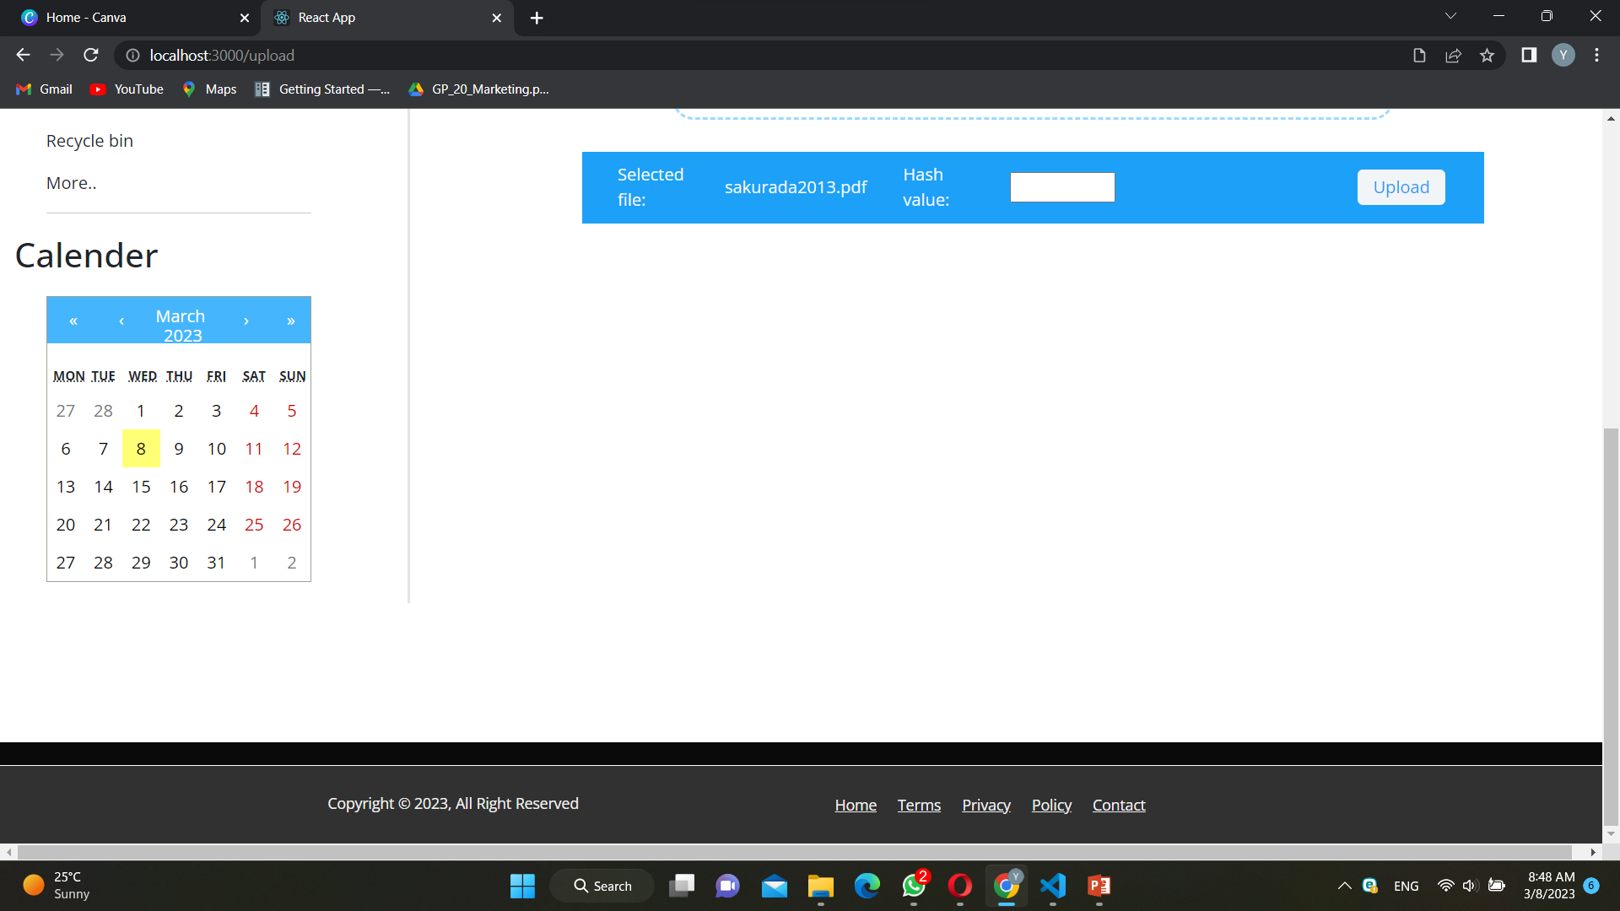
Home page

Slide 7
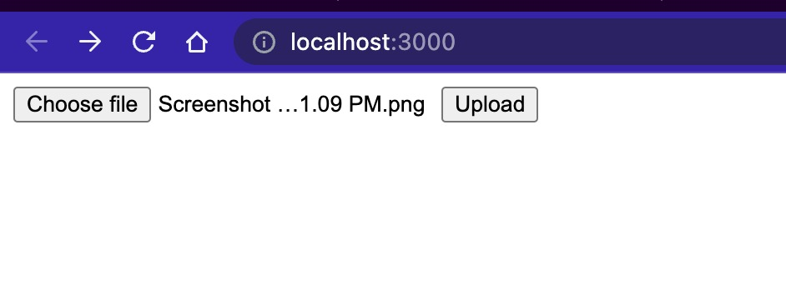
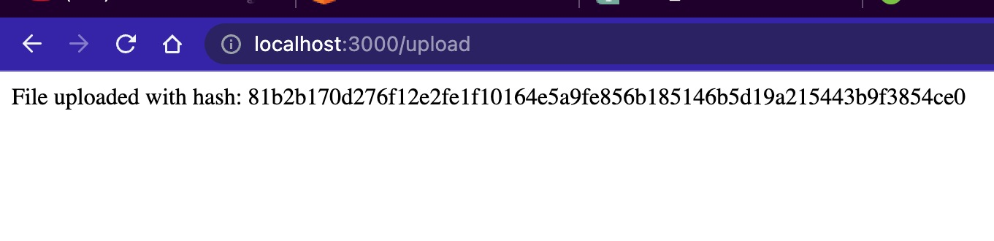
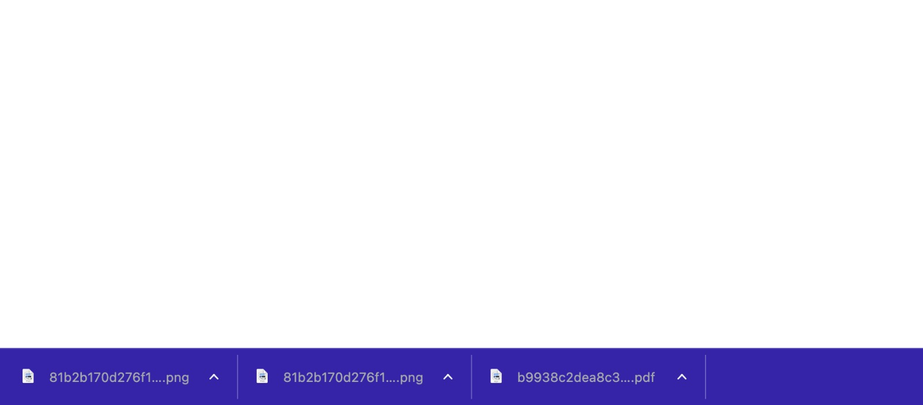
Document upload & download
Using AWS S3 server.
Using multer function.
Using IPFS.
Using Docker & apache.

Slide 8
Thank You

